Slide 1
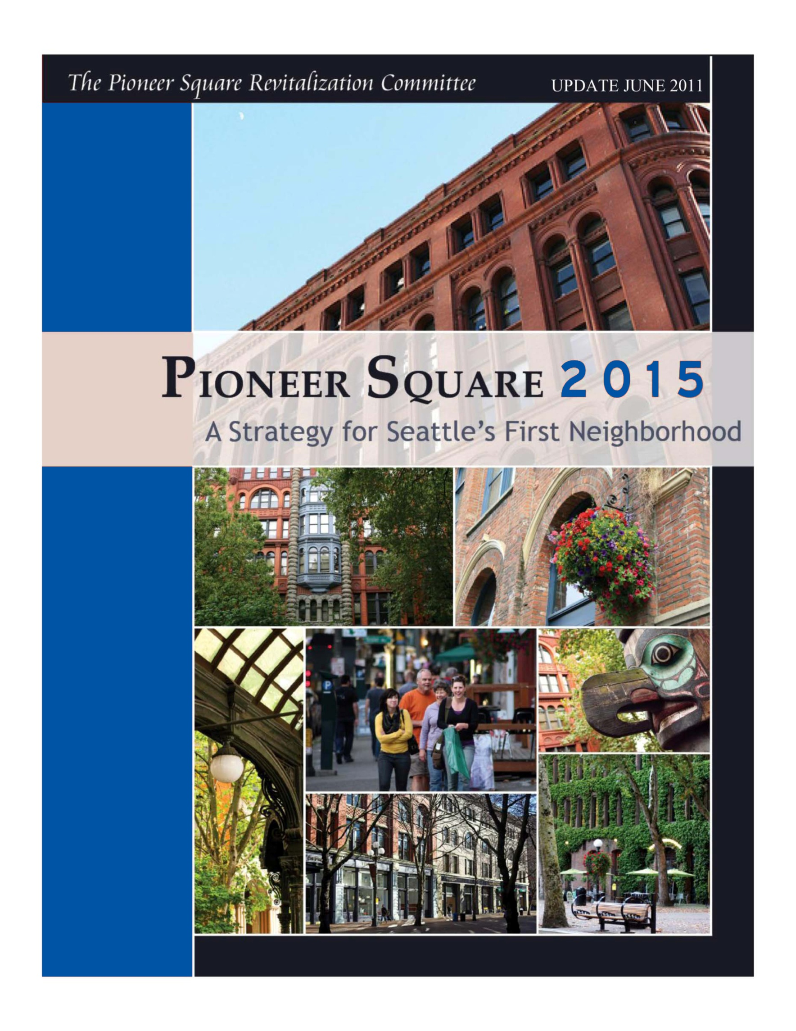

Slide 2
Pioneer Square 2015
A Strategy for Seattle’s First Neighborhood
Overview
The Pioneer Square Commercial District Revitalization Project is an initiative to improve the overall business health of Pioneer Square.
The project began in December 2009 with an analysis of Pioneer Square’s economy and the neighborhood’s major business needs and opportunities. Over the next six months, members of the Pioneer Square business community met to discuss these priorities and the actions needed to create a vibrant and robust commercial business district.
The outcome was a set of actionable community and city strategies to address key issues around business retention and growth, retail mix, and business capacity in Pioneer Square, released June 2010 as Pioneer Square 2015, A Strategy for Seattle’s First Neighborhood.
This is a one-year highlight of the Community and City’s progress to date in the following goal areas, and lays out the City’s priorities for the rest of 2011:
Community Actions:
  Actively Engage Businesses in Supporting Economic Growth
  Build the Neighborhood’s Organizational Development and Advocacy Capacity
  Focus on the District’s Historic Building Assets and Enhance the Build Environment
  Effectively Market, Brand and Promote Pioneer Square
  City Actions
  Support Pioneer Square’s Historic Buildings and a Positive Development Environment
2) Provide Economic Development Support and Investment
3) Provide Supportive Utility, Parking, and Transportation Infrastructure
4) Ensure an Environment of Public Safety and Civility
5) Looking Ahead

Slide 3
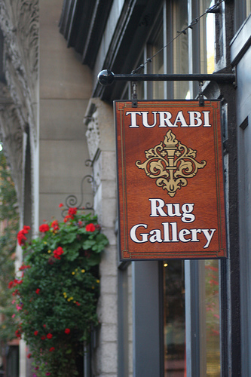
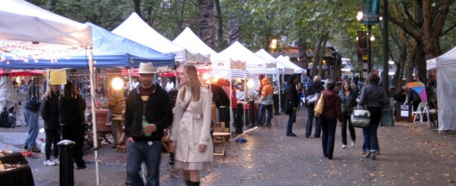
1
Community Actions
Actively Engage Businesses in Supporting
Economic Growth
A. Support Existing and Emerging Economic Clusters
    Communication and outreach on-going Alliance activity
    Increase in use of social media and advertising
    Increase in retail and First Thursday promotion in 2011
    Continued outreach and inclusion of various constituencies
    Promotion Committee meets monthly and hosts promotions and events; Madame Damnable Cocktail Crawl, Seattle Square, Holiday
    Alliance staff and volunteers working on retail plan for neighborhood and building district capacity to recruit and retain independent retail
    Partner with WSDOT to open tourist/project information center in neighborhood
B. Research and Inventory the Businesses and Nonprofit Organizations
to Understand “Who is in Pioneer Square” and Accurately Characterize
the Economy
Comprehensive business inventory completed during summer 2010; report of economy distributed
Analysis of tech cluster completed in June 2011; will be distributed summer 2011
Business inventory will be updated during 3rd and 4th quarters of 2011
C. Meet with Businesses Individually and In Groups to Engage Them, Solicit Their Needs for Business Retention and Expansion
Business needs solicited in annual survey
More frequent and formal neighborhood updates have begun
Alliance hosted numerous neighborhood forums: Trail to Treasure, King Street Station Hub, AWVRP, Parking, etc
COMMUNITY ACTIONS

Slide 4
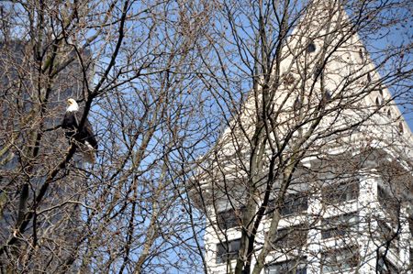
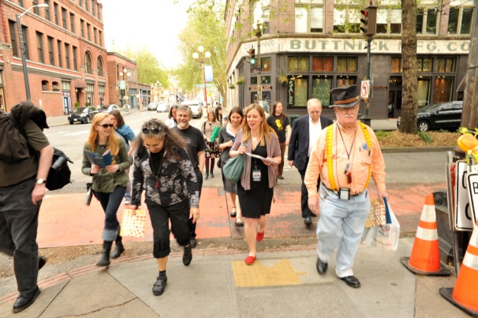
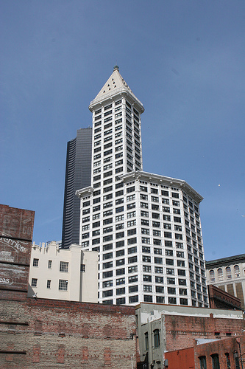
2
Community Actions
Build the Neighborhood’s Organizational
Development and Advocacy Capacity
A. Support Public Civility Improvement Efforts
Civility steering committee working on access, signage, and development of public restroom facilities for the neighborhood. Will be included on 2011 Neighborhood Map & Guide
Alliance hosted meeting with human services CEO’s; began dialogue on common interests and creating a civil environment for all
B. Address Mismatched Boundaries
Outreach begun to increase Business Improvement Area (BIA) board
In partnership with Seattle’s Office of Economic Development (OED), working with BIA consultant; analysis of assessment methodology and plan for changes by December 2011
COMMUNITY ACTIONS
C. Host Forums and Events to Hear Ideas and Generate Discussion in Support of Economic Development
Economic Restructuring Committee meets monthly to enhance business recruitment and retention
Alliance hosted numerous neighborhood forums including; by request, quarterly business mixers
D. Develop Relationships with the Nightclubs
Alliance, City, Nightclub meetings have begun

Slide 5
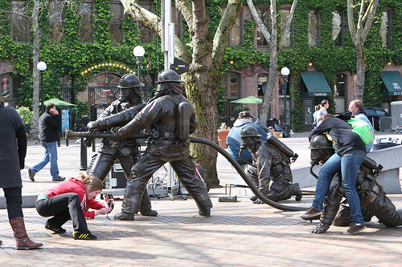
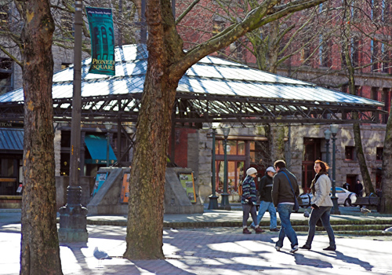
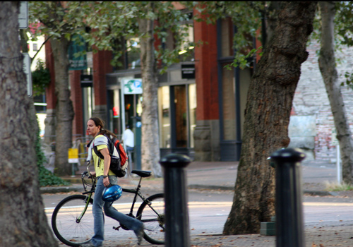
3
Community Actions
Focus on the District’s Historic Building Assets and Enhance the Built Environment
A. Increase Residential Development
and Density in Pioneer Square
Support for North Lot Development
Supported the development of a new residents council
In-fill projects much more likely with Livable South Downtown passage
B. Address Vacant, Dilapidated, and Underused Buildings
Launched Storefronts Seattle in August 2010 to activate vacant storefronts; program continues with increased funding
Facilitated the public mural on the Metropole building
Completed inventory and map of dilapidated and neglected buildings; outreach to owners underway
C. Support Implementation of the Livable South Downtown Plan
Livable South Downtown Plan passed
D. Advocate for the Maintenance, Improvement, and Activation
of Public Spaces
Alliance Design Committee meets monthly to address issues of built environment and public space
Partnership with Center City Parks for Occidental Square Park activation and staffing
Partnership with DSA/MID on neighborhood clean and safe activities
Partnership with Alley Network for creating more pedestrian friendly, usable green ways in the neighborhood
Design committee partnered with City for inventory and replacement plan for sidewalk prism lights.
COMMUNITY ACTIONS

Slide 6
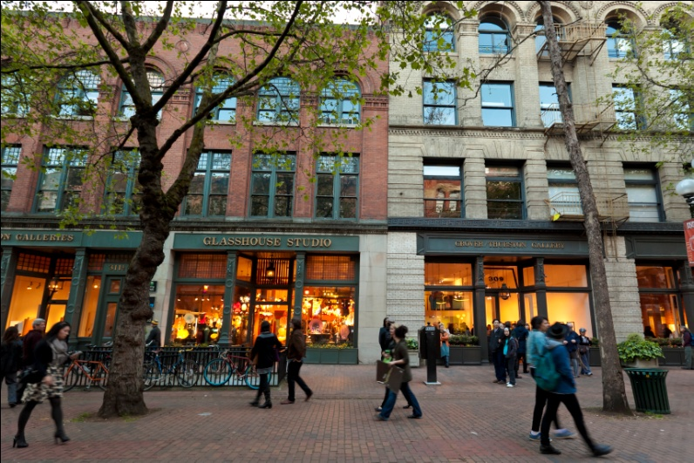
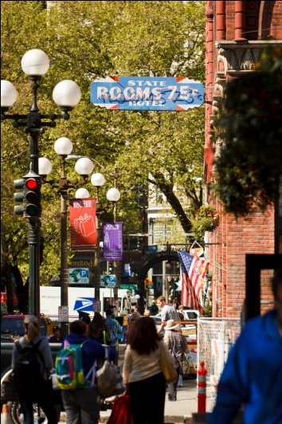

4
Community Actions
Effectively Market, Brand, and Promote
Pioneer Square
COMMUNITY ACTIONS
A. Develop a Comprehensive PR, Marketing and Branding Strategy
for Pioneer Square
Alliance staff have seen the beta for new branding; launch July 2011
Develop a Communications Plan that Builds on the Square’s Unique Mix of Assets
Increased positive relationships with the media; telling a new story about Pioneer Square
C. Support the Trails to Treasure Program
Trail to Treasure (T2T) Master Plan completed, walking map printed and launch event held May 20, 2011
T2T advisory committee to meet during June 2011 to define next steps
Neighborhood Walking Tours available Summer 2011

Slide 7
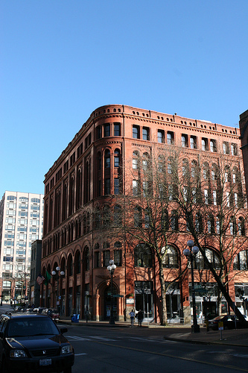
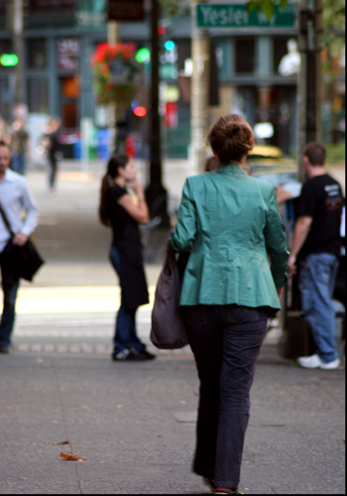
1
City Actions
Support Pioneer Square’s Historic Buildings
and a Positive Development Environment
Facilitate Development and Adaptive
Reuse Incentives
South Downtown rezone legislation was adopted on April 25, 2011 to increase residential density.
North Lot mixed-use development project is under consideration for New Markets Tax Credits financing. This funding will dramatically improve the financial feasibility of the project.
City restoration of the King Street Station is fully funded ($50 million) and the final phase is underway.
Address Vacant and Blighted Buildings
The Department of Planning and Development (DPD), the Office of Arts and Cultural Affairs (OACA), and the Office of Economic Development (OED) collaborated with the Alliance for Pioneer Square (APS) on the Storefronts Seattle project – putting art in vacant retail spaces to enliven neighborhood streetscapes, make spaces more attractive to prospective tenants and provide opportunities for artists to display their work.
C. Implement Supportive Building
and Energy Code Provisions
DPD is working with the Preservation Green Lab (PGL), a program of the National Trust for Historic Preservation, to develop performance-based energy codes for existing and historic buildings. PGL is looking for a pilot project to test performance-based approaches, and it is very interested in a project in Pioneer Square. Building owners can realize reductions in operating costs with an easier pathway to investing in deep energy efficiency retrofits and save operating dollars.
CITY ACTIONS

Slide 8
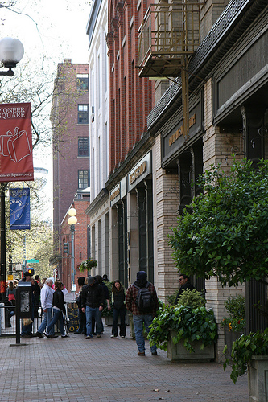
2
City Actions
Provide Economic Development Support
and Investment
Identify New and Emerging Clusters; Recruit Complementary Businesses
  The Office of Economic Development (OED) awarded a $100,000 grant to the Alliance for Pioneer Square (APS) to implement its economic development strategies including supporting business and retail development by:
    Attracting businesses through a retail attraction plan and materials, and
    Helping the businesses organize themselves and sustain these activities by improving the Business Improvement Area (BIA) assessment and boundaries.
  Pioneer Square broadband infrastructure improvement will retain and attract high tech businesses
Align the City’s Business and Economic Development Activities to Support Pioneer Square’s Business Climate and Activity
The Office of Economic Development’s grant to the Alliance for Pioneer Square includes strengthening the attractiveness and appeal of the neighborhood through clean and safe programs and marketing and promotion activities such as:
  Organize and advertise events to draw people into the district: Art in the Park, Salsa Saturdays, Holiday retail promotion, Alley events, Seattle Square Market and more
  Complete the neighborhood branding with new website and materials
  Replace historic sidewalk lights
The Department of Neighborhoods (DON) provided $85,000 in Neighborhood Matching Funds to support the community’s Trail to Treasure historic walking tour.
CITY ACTIONS
Support Economic Activity Data Collection Efforts
    OED has prepared a survey and inventory of Pioneer Square’s businesses and currently provides a summary of the B&O activity in the neighborhood by business category annually.

Slide 9
3
City Actions
Provide Supportive Utility, Parking, and
Transportation Infrastructure
Ensure Effective Utility and Technology Systems
The City installed conduit along First Avenue for future use by the City and King County Metro. The City is making the excess capacity in the conduit available to internet service providers.
The City issued a Request for Proposal aimed at internet service providers interested in leasing the excess conduit space in order to offer fiber based broadband Internet in Pioneer Square. The Request for Proposal process resulted in a proposal from Comcast to install fiber and offer fiber based internet services along First Avenue South in Pioneer Square. The City will begin negotiations with Comcast and anticipates service to be available in fall 2011. Pioneer Square businesses and residents will now have the ability to obtain dramatically faster internet services which creates opportunities to enhance the economic environment.
Seattle City Light (SCL) has committed to completing routine street light repairs within 10 working days. For more complicated repairs, City Light will provide estimated repair times. Customers can track progress online at www.seattle.gov/light
City Light is improving power service and reliability to Pioneer Square and the downtown core through its replacement of transmission and distribution cables. In 2010, Pioneer Square underground vaults were upgraded in anticipation of new distribution lines.
City Light is providing additional performance improvements with shortened service connection scheduling for those customers who need service installation or service improvements.
CITY ACTIONS
Support Transportation Improvements and Mitigation
First Hill Streetcar line will serve Pioneer Square, providing a link to the Chinatown/International District, Yesler Terrace, First Hill and Capitol Hill.
Seattle Department of Transportation (SDOT) has started a community engagement process about how to activate King Street Station along with other development projects (King Street Station Transportation Multimodal HUB Area planning).
Effectively Manage Parking Supply and Demand
SDOT is currently updating its 2010 parking study to assess the effects of the recent parking rate changes. The goal is to achieve an average of one to two available spots per block, to create parking turnover to help business customers. SDOT will use this data to determine if rate adjustments are needed in 2012.
Extended paid parking into the evening in Pioneer Square will be delayed until 2012, to allow SDOT to collect additional data in 2011.
E-Park launched in September 2010 in the Commercial Core and will expand to Pioneer Square in 2011-2012.
The Pioneer Square/Commercial Core rate boundary will be moved from Yesler Way to Columbia Street, in recognition of the traditional neighborhood boundary. This will lower rates at about 20 pay stations to $3.50/hour from $4/hour.

Slide 10
4
City Actions
Ensure an Environment of Public Safety
and Civility
Improve Public Safety Experience and Perceptions
The Department of Planning and Development (DPD) and the Alliance for Pioneer Square (APS) have convened a community task force to explore public restroom options, a community priority.
Artsparks – Seattle Parks Department and Seattle’s Office of Arts and Cultural Affairs (OACA) continue highly successful programming in Occidental Park.
Seattle Police Department (SPD) increased its walking patrols at the beginning of April 2010. SPD routinely conducts undercover drug operations at Fortson Square and other locations in Pioneer Square, resulting in the arrest of chronic drug dealers.
Nighttime amplified noise regulations were recently established targeting chronic offenders while finding a good balance between residents and business owners.
B. Improve Human Services Programs and Strategies
The Mayor’s Office, DPD, Human Services Department (HSD) and SPD worked with APS, Real Change, and the Seattle/King County Coalition on Homelessness to address chronic camping issues at Masin’s Furniture.
DPD and APS have convened a roundtable forum to better engage human service providers in the Pioneer Square neighborhood. HSD and the Compass Center are co-chairing.
CITY ACTIONS

Slide 11
Pioneer Square 2015
A Strategy for Seattle’s First Neighborhood
Looking Ahead
The City will support a successful North Lot development through its financing and permitting tools.
The City will designate an individual to coordinate communications with City departments and the community about construction impacts on parking availability.
The City will examine parking usage and rates and adjust according to data collected.
The City will re-examine feasibility of a public restroom in Pioneer Square, including Fire Station 10.
The City will work with Comcast to expand broadband in Pioneer Square.
Street Car service will start in 2013.
The City will work with Pioneer Square artists to prioritize the retention of artists workspace in the neighborhood.

