Slide 1
PIONEER SQUARE COVID-19 INFORMATION AND UPDATES July 17, 2020 1:30-2:30p
Notes:
CHRIS

Slide 2
TODAY’S AGENDA
THE FOLLOWING TOPICS WILL BE COVERED DURING TODAY’S SESSION
Questions?
Type them into the chat box or state that you have a question and we will address them or call on you to speak intermittently throughout the presentation and at the end.
Current public health and phases overview
Occidental Square Pavilion Project Update (presented by Beth Purcell and Nate Cataldo, Eric Peterson; Schuchart)
Occidental Square Activation Update
(presented by Jennifer Casillas; DSA)
JumpStart Seattle Overview
2020 Budget Rebalancing Overview
Paid On-Street Parking Resumption
Ongoing Alliance Project Updates
Public Safety Resources
Notes:
CHRIS
*6 - Mute or unmute yourself on phone

Slide 3
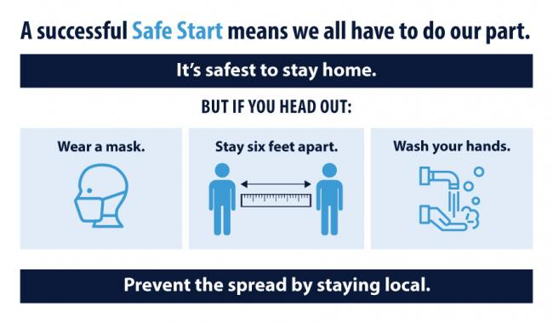
CURRENT SITUATION
PUBLIC HEALTH
On May 4, Gov. Inslee announced his 4-phase reopening plan. On May 29, Gov. Jay Inslee released an updated, county-by-county based “Safe Start” plan. King County is currently in Phase 2 of the “Safe Start” plan.
Notes:
CHRIS
Juky 28 phase pause
Gov. Inslee on Thursday announced a rollback to the state’s “Safe Start” plan concerning gatherings for counties in phase 3. Beginning Monday, gatherings in such counties will be limited to no more than 10 people. The previous limit for phase 3 was 50 people. Inslee also said he was prohibiting all live entertainment, both indoor and outdoor

Slide 4
PHASES
Notes:
CHRIS

Slide 5
Notes:
Beth Purcell and Nate Cataldo, Eric Peterson

Slide 6
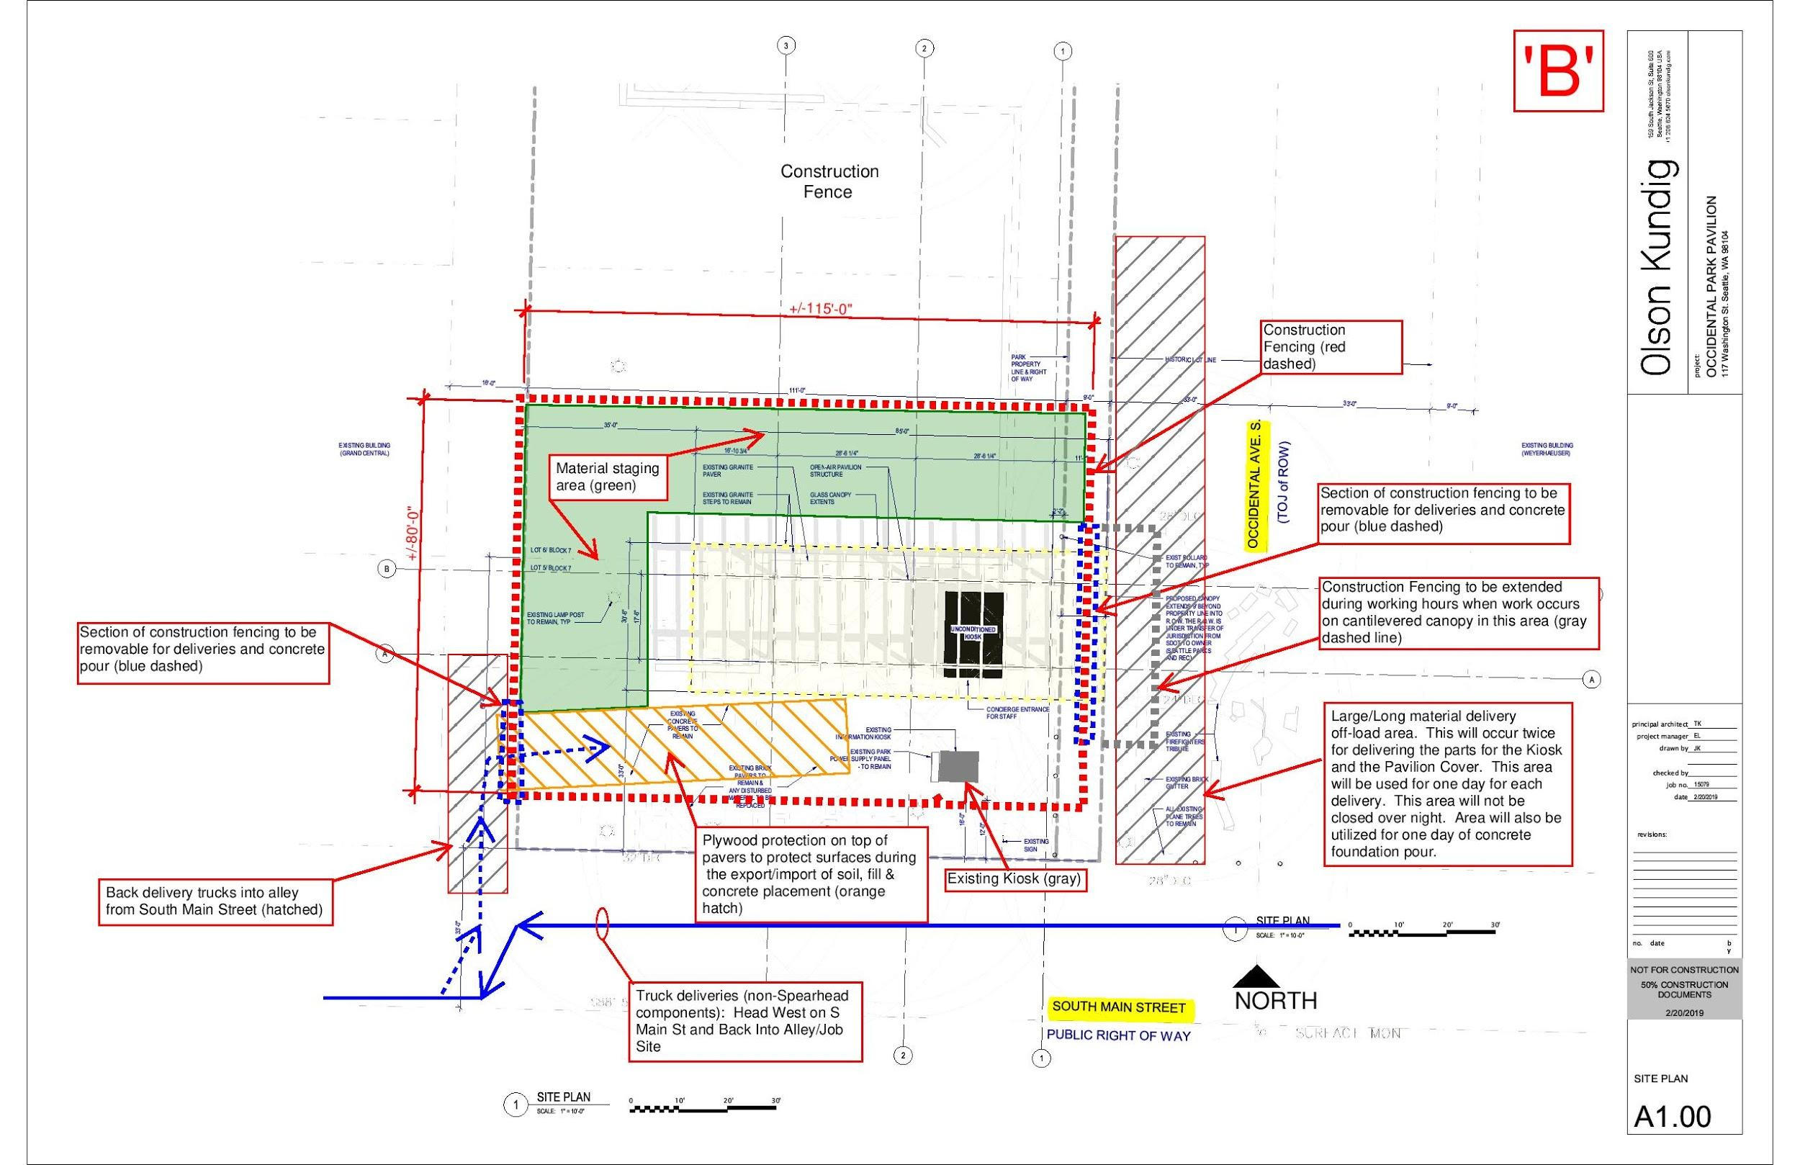
Notes:
BETH + NATE

Slide 7
https://www.seattle.gov/parks/about-us/current-projects/occidental-square-park-projects
Notes:
BETH + NATE

Slide 8
Notes:
JENN

Slide 9
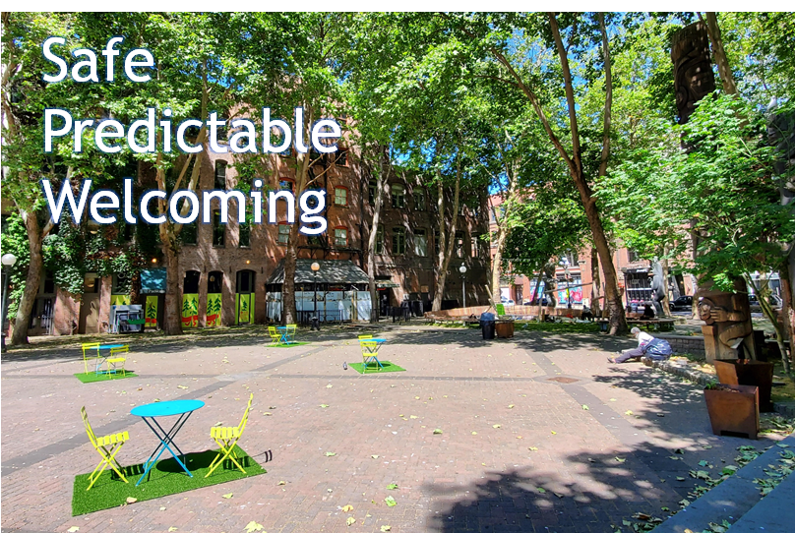
Notes:
JENN

Slide 10
JUMPSTART SEATTLE
On July 6th, the Seattle City Council passed the JumpStart Seattle progressive revenue plan to address COVID response, essential city services and affordable housing
Businesses with at least $7 million in annual payroll will be taxed at 0.7% to 2.4% on salaries and wages spent on Seattle employees who make at least $150,000 per year, with tiers for various payroll and salary amounts.
JumpStart Seattle is anticipated to raise more than $200 million per year for housing, local business assistance, and community development in the long term.
Notes:
JESSA

Slide 11
2020 CITY BUDGET REBALANCING
With COVID impacts on City Budget, Council is working on rebalancing the 2020 budget to account for a $300 million shortfall
In response to national calls placed on defunding police departments, Council is entertaining potential cuts of up to 50%, while investing money into other types of support services
There isn’t much clarity on the timeline or process of any cuts to SPD’s budget as Council only began discussing this past Wednesday at their Select Budget Committee
The Alliance, along with other BIAs in the city, is calling for a robust and meaningful engagement process to determine the best path forward; we will provide additional updates as more details become available
Notes:
JESSA

Slide 12
PAID ON-STREET PARKING RESUMPTION
Starting Monday, July 13, SDOT reinstated on-street paid parking and hourly time limited parking enforcement.
Parking will be $0.50/hour in all paid areas; the minimum rate allowed according to the Seattle Municipal Code.
The rate will remain unchanged for at least a month while SDOT reviews data to determine parking activity and occupancy in neighborhood business districts.
Parking Enforcement Officers will initially be focused on education and voluntary compliance of paid parking as customers return to neighborhood businesses.
Notes:
JESSA

Slide 13
ALLIANCE RESOURCES
UPDATE
Regular information dissemination
Weekly COVID-19 resources, bi-weekly public safety message
Pioneer Square Business Owner/Manager FB
Support Local – Pioneer Square Marketplace
#SupportPSQ campaign
Mural Project update
Notes:
THEMBELA

Slide 14
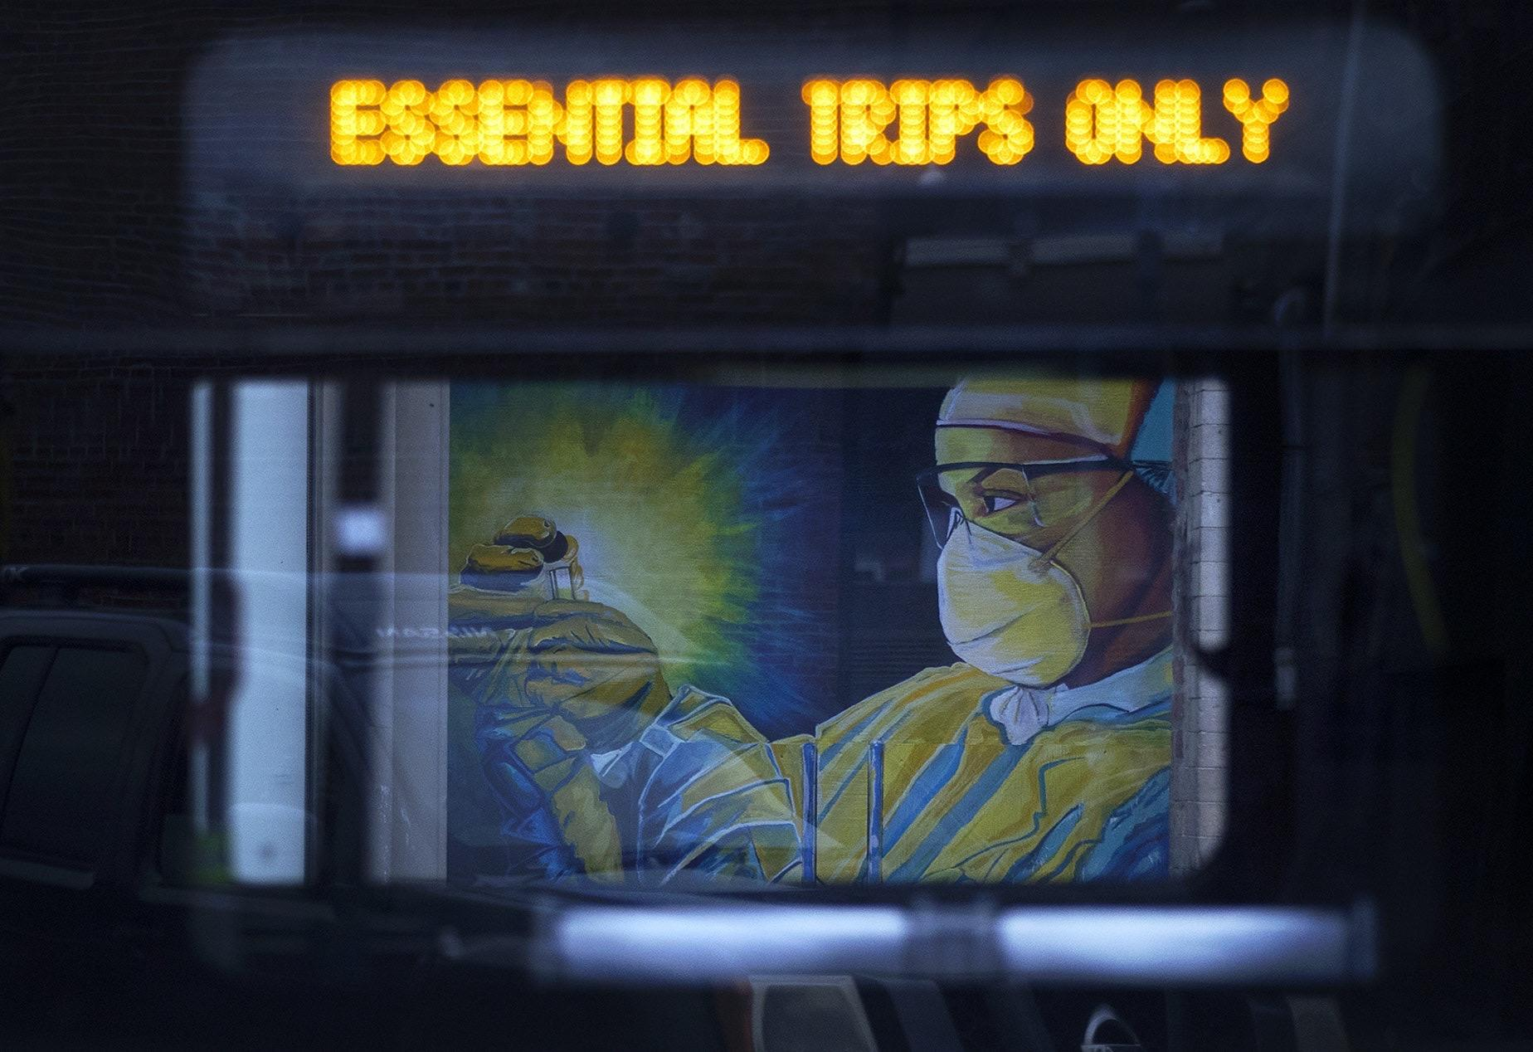
MURAL PROJECT UPDATE
Thank you to the artists, businesses, property managers that participated!
Funding for APS murals made possible by
Pioneer Square BIA
Pioneer Square Residents’ Council
Donations
Taking down your mural/plywood
Remove boards
Fill holes left behind
Touch up paint
Notes:
SARA

Slide 15
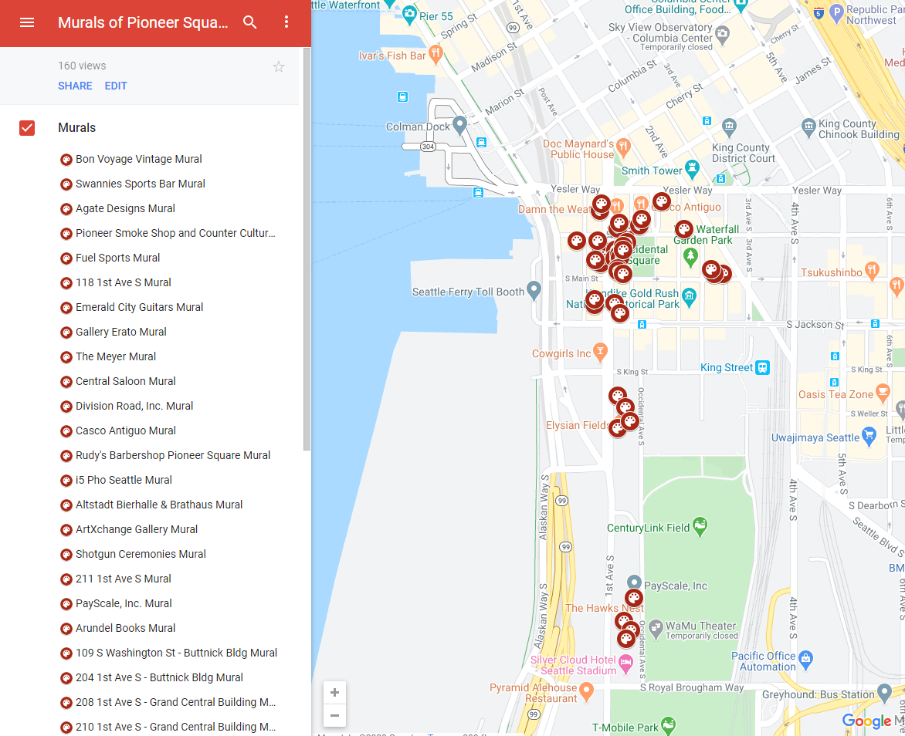

Slide 16
PUBLIC SAFETY RESOURCES
MID operations and hours:
Clean team Sun-Sat 8:30a-2p (effective July 12)
Safe team resume operations on Aug 1, Sun-Sat starting September 1
Outreach team to resume operations five days a week effective July 27
Securing Businesses during closures
SPD Trespass Program
CPTED Assessments and Security Site Assessments
Community Police Team Officers: (206) 684-8996
SPD West Precinct online resources
SDCI Tips for Securing Vacant Properties

Slide 17
NEXT STEPS AND FOLLOW UP
Today’s slides and recording shared after this meeting, along with feedback form
Next Pioneer Square COVID-19 Updates and Information Session to be held on Friday, August 21st, 2020 1:30-2:30 PM
Visit allianceforpioneersquare.org for full COVID-19 resources
Email info@pioneersquare.org to sign up for weekly COVID-19 updates

Slide 18
QUESTIONS?

Slide 19
NEXT STEPS AND FOLLOW UP
Today’s slides and recording shared after this meeting, along with feedback form
Next Pioneer Square COVID-19 Updates and Information Session to be held on Friday, August 21st, 2020 1:30-2:30 PM
Visit allianceforpioneersquare.org for full COVID-19 resources
Email info@pioneersquare.org to sign up for weekly COVID-19 updates

