Slide 1
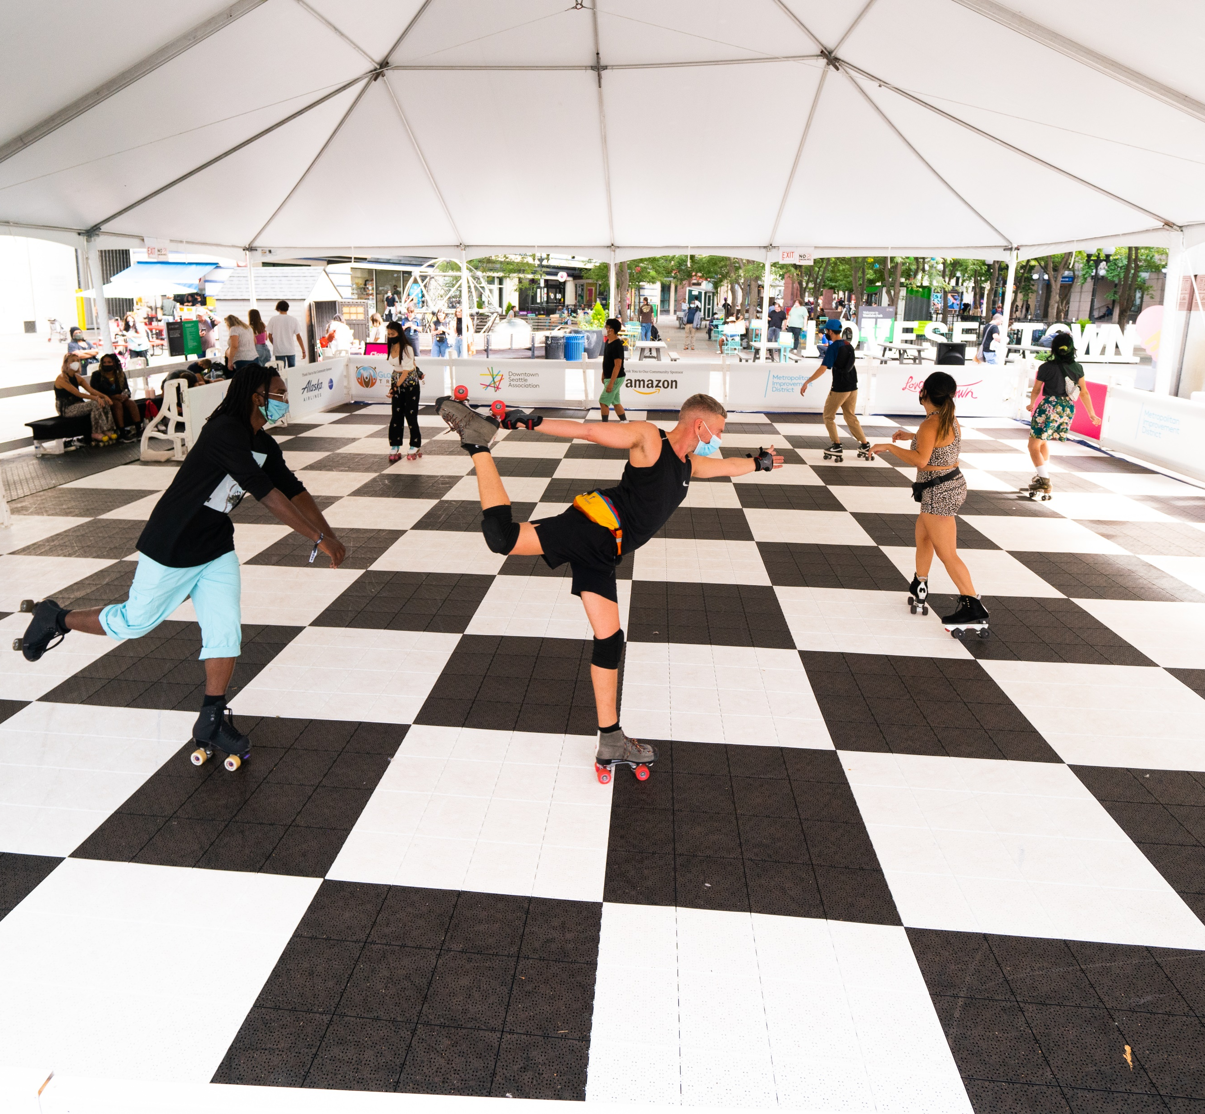
All Star Week
Activations Occidental Park
July 8-11th

Slide 2
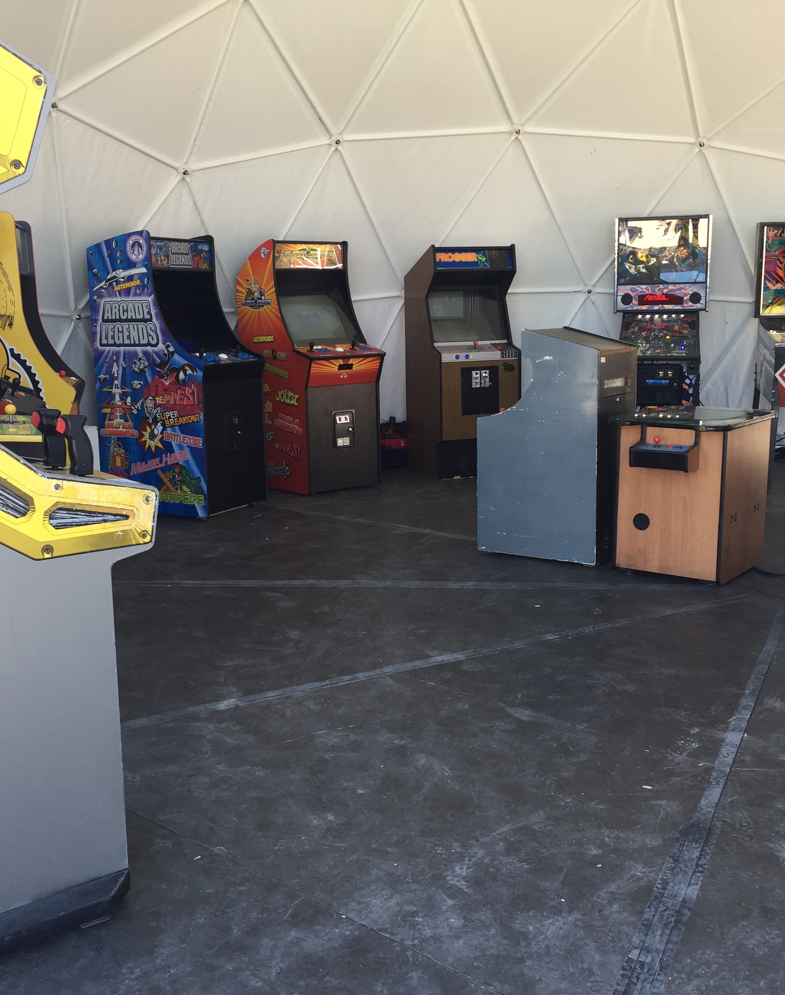
Saturday & Sunday 11-6pm
July 8th and 9th
Featured Activation Roller Rink
  40X80 Roller Rink
  Free to the public, All year galaxy sports will staff the rink
DJs (2-6pm)
  Working with local DJs to have a family friendly vibe
Northwest Flash Arcade(15 games)
  We will set up a tent and have an arcade in the mall area
  DSA partners from the Northwest event show and proven track record onsite maintenance
Caricature Artist (4-6pm)
  The goal is to have memorable keepsakes from the weekend
Beer Garden (2-6pm)
  Capture peak times of foot traffic
  PNW bar events running the gardens

Slide 3
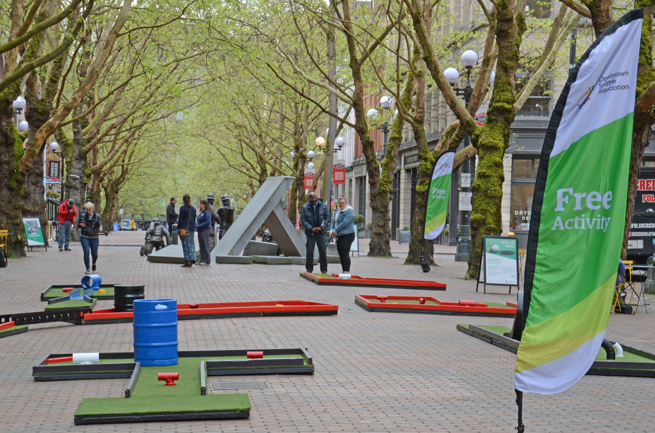
Monday & Tuesday 11-6pm
July 10th & 11th
Roller rink
  Hired skaters to entice people into the rink
  Prizes and giveaways throughout the day (Gloves, M’s Tickets etc..)
DJ from (2-6pm)
Flatstick Pub
  9-hole mini golf course
  DSA staff to manage (hand out clubs and score cards)
Face Painters(4-6pm)
  Work with Face paint Seattle to have a couple of artist to paint up kiddos with a Baseball theme
  The time is flexible, and we wanted to capture as many kids heading to playball park and T-Mobile
Beer Garden (2-6pm)
  Capture peak times of foot traffic
  PNW bar events running the gardens
Downtown Summer Sounds Concert on Tuesday Noon to 1:30pm
  Ahamefule Oluo
  Set up, will be the south end by the kids play area facing the pavilion

Slide 4
Thank You
Michael Johnson
Director of Parks and Public Realm Operations
michaelj@downtownseattle.org

